Slide 1



LARGE SCALE COMPUTING ON CLOUD
ASPECT BASED SENTIMENT ANALYSIS OF YELP
Team 1
01

Slide 2
The Team
Business Problem
Example Results and Insights
Business Value & Benefits
Proposed Solution Overview
Dataset Description
5V’s of Big Data
Cloud Computing Tools
Demo
Conclusion
Contents
02

Slide 3





The Team
Piyush Agrawal
hongyuan shaozhu
Yiren Sun
Jayda Niblet
03

Slide 4

Business Problem
Problem: Businesses face challenges in extracting actionable insights from vast amounts of unstructured customer reviews.
Opportunity: Leverage advanced sentiment analysis on Yelp reviews to identify customer satisfaction trends and improve operational decisions.
Business Impact: Helps businesses improve service quality, enhance customer experiences.
04
Notes:
In today’s digital landscape, businesses receive thousands of reviews across various platforms. Analyzing this data manually is inefficient. By applying Advanced sentiment analysis and cloud computing, companies can quickly process large-scale feedback and identify specific areas needing attention.

Slide 5

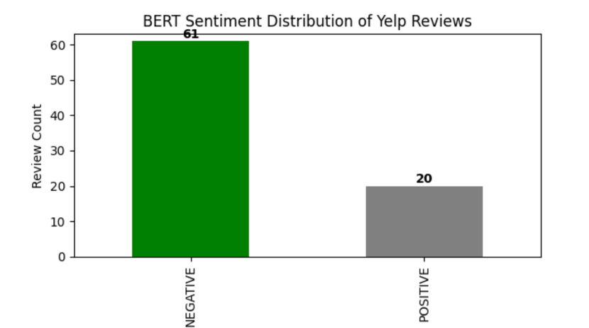
Example Results and Insights : Available
Input : Review: “The pizza was delicious but overpriced. The waiter was rude, but the ambiance was nice.”
Output: Sentiment Analysis: Positive
Aggregated Sentiment
05
Notes:
“In this slide, we introduce the fundamental sentiment analysis approach used in our project. We analyzed Yelp reviews to determine the overall sentiment of customer feedback. Here, we have a sample review: ‘The pizza was delicious but overpriced. The waiter was rude, but the ambiance was nice.’”
“Using BERT-based sentiment analysis, the overall sentiment was classified as ‘Positive.’ However, this traditional approach has limitations. It provides a single sentiment score for the entire review but does not differentiate between various aspects like food, service, and price. This is a challenge because a review may contain both positive and negative sentiments for different elements of the customer experience.”

Slide 6
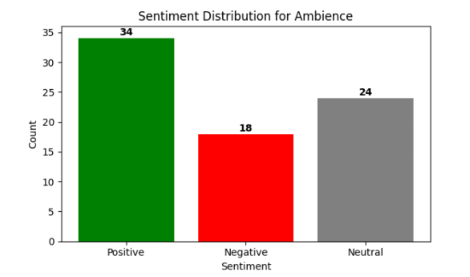
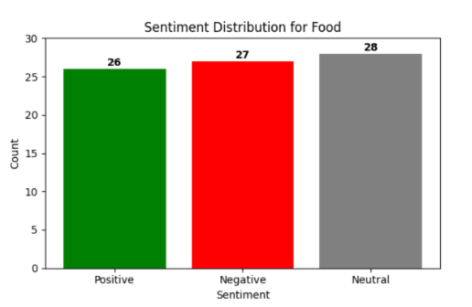
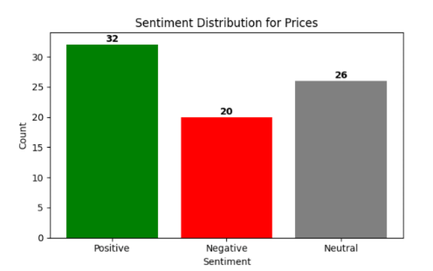
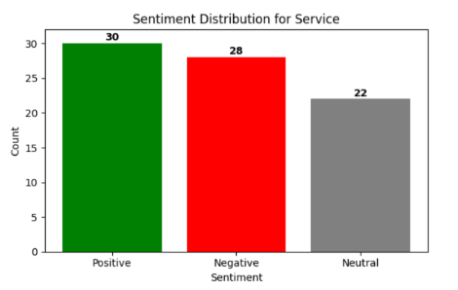
Example Results and Insights : Our Aim
Input : Review: “The pizza was delicious but overpriced. The waiter was rude, but the ambiance was nice.”
Output: Aspect-Based Sentiment Analysis:
Food: Positive
Service: Negative
Ambiance: Positive
Price: Negative
06
Notes:
“Now, let’s move beyond overall sentiment analysis and introduce Aspect-Based Sentiment Analysis (ABSA). Instead of providing a single sentiment score, this approach breaks the review into different aspects and analyzes sentiment for each one separately.”
“Looking at the same example review, we now analyze it across four key aspects:”
• Food: Positive
• Service: Negative
• Ambiance: Positive
• Price: Negative
“This allows businesses to gain deeper insights into customer feedback. For instance, if a restaurant consistently receives negative sentiment in the ‘Service’ category but positive sentiment in ‘Food,’ they can focus on improving customer service without worrying about food quality.”

Slide 7

Business Value & Benefits
Real-Time Sentiment Monitoring:
Targeted Business Improvements:
Enhanced Customer Experience:
✔ Continuously track customer feedback to detect emerging trends.
✔ Identify shifts in sentiment and act promptly to address concerns.
✔ Pinpoint key areas needing improvement, such as service, pricing, and product quality.
✔ Use sentiment-driven insights to make data-backed business decisions.
✔ Address recurring pain points to improve customer satisfaction.
✔ Personalize offerings based on customer sentiment and feedback trends.
07
Notes:
Real-Time Sentiment Monitoring
“With real-time sentiment tracking, businesses no longer have to wait for quarterly reports to understand customer concerns. They can immediately detect negative feedback spikes and take corrective action—whether it’s improving service quality, addressing product issues, or refining pricing strategies.”
Targeted Business Improvements
“Instead of making generalized business changes, this model helps pinpoint exactly where improvements are needed. For example, if multiple customers highlight slow service but praise the food quality, the business can focus on staff training rather than unnecessary menu changes.”
Enhanced Customer Experience
“At the core of sentiment analysis is customer experience enhancement. Understanding what frustrates or delights customers allows businesses to proactively address pain points. Whether it’s improving service interactions or refining product pricing, this model empowers companies to create customer-centric strategies.”

Slide 8

Data Processing Workflow
Processing
Insights
✔ Data Extraction: Identify and filter relevant reviews from large datasets.
✔ Data Cleaning: Remove duplicates, stopwords, and irrelevant content to enhance accuracy.
✔ Aspect Identification: Categorize feedback into service aspects like food, service, ambiance, and pricing for deeper insights.
✔ Sentiment Analysis: Use Transformer models (BERT, RoBERTa) to classify sentiment for each aspect.
✔ Visualization: Generate interactive dashboards for trend analysis and decision-making.
08
Notes:
Processing Stage:
“First, we start by extracting relevant reviews from our dataset, filtering them based on specific businesses or keywords. Next, we clean the data by removing duplicates, stopwords, and unnecessary content to ensure better model accuracy. Finally, we perform aspect identification, breaking reviews into Food, Service, Ambiance, and Pricing categories to get deeper insights.”
Insights Stage:
“Once the data is processed, we apply Transformer-based sentiment analysis (BERT & RoBERTa) to classify sentiment for each aspect separately. Finally, we visualize insights using interactive dashboards, allowing businesses to track sentiment trends and make data-driven decisions.”

Slide 9

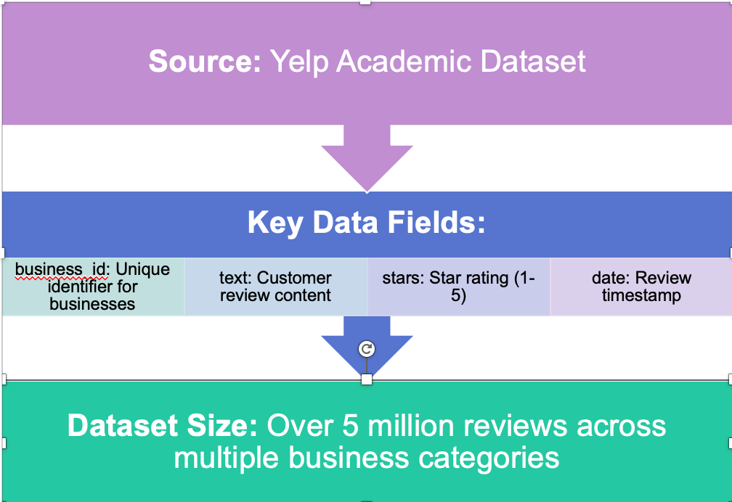
Dataset Description
09
Notes:
“This slide provides an overview of the dataset we used for sentiment analysis— the Yelp Academic Dataset. This dataset contains millions of customer reviews across various business categories, making it ideal for training and evaluating our sentiment analysis models."
“This dataset contains over 5 million customer reviews, providing a rich and diverse dataset for training our sentiment analysis models. With such a vast dataset, we can generate accurate and meaningful insights that businesses can use to enhance their operations and customer experience.”

Slide 10
The 5V’s of Big Data
01
Volume
04
Veracity
Processing over 5 million+ customer reviews for meaningful insights.
Ensuring data accuracy and reliability through robust cleaning methods. Remove Duplicates and spam
02
Velocity
Near real-time sentiment analysis for quick decision-making. Negative feedback, poor service
05
Value
Extracting actionable insights that help optimize business strategies.
03
Variety
Customer-reviews: ratings, text, categories, and timestamps across multiple formats.
10
Notes:
Volume
“Volume refers to the sheer amount of data available. In our case, we process over 5 million customer reviews from the Yelp dataset. The larger the dataset, the better the insights, as we get a comprehensive view of customer sentiment trends.”
Velocity
“Velocity describes the speed at which data is generated and processed. With the growing amount of online reviews and feedback, businesses need near real-time sentiment analysis to make quick decisions. For instance, if negative feedback spikes for a restaurant due to poor service, management can take immediate action to resolve issues.”
Variety
“Customer reviews come in various formats, including text, ratings, categories, and timestamps. Our model handles structured data (star ratings) and unstructured data (text reviews), allowing for a deeper and more nuanced analysis.”
Veracity
“Not all data is reliable. Some reviews may be spam, biased, or misleading. That’s why we implement data cleaning techniques—removing duplicates, stopwords, and irrelevant content—to ensure the accuracy and reliability of our sentiment analysis.”
Value
“Ultimately, the most important aspect is Value. Businesses can extract actionable insights from Big Data to optimize their strategies. By understanding customer sentiment at scale, they can make informed decisions to improve service, pricing, and customer experience.”

Slide 11

Cloud Computing Tools
Data Storage
Data Processing
AWS S3 – a secure and scalable way to store Yelp reviews.
STORAGE
PROCESSING
AWS EMR – Use distributed computing for large-scale data transformation.
Model Deployment
Visualization
DEPLOYMENT
VISUALIZATION
AWS QuickSight – Interactive dashboards for business insights.
AWS SageMaker – Train and deploy models using machine learning method
.Real-time analysis.
11
Notes:
“This slide outlines the key cloud computing tools we used to build and scale our sentiment analysis system. Each of these AWS services plays a crucial role in different parts of our workflow.”
Data Storage – AWS S3
“AWS S3 provides a secure and scalable way to store Yelp reviews, enabling efficient access and retrieval for analysis.”
Data Processing – AWS EMR
“AWS EMR allows us to process large-scale datasets efficiently using distributed computing, making it ideal for handling millions of customer reviews.”
Model Deployment – AWS SageMaker
“We use AWS SageMaker to train and deploy machine learning models for sentiment classification, ensuring scalable and real-time analysis.”
Visualization – AWS QuickSight
“Finally, AWS QuickSight generates interactive dashboards, allowing businesses to track sentiment trends and make data-driven decisions in real time.”

Slide 12


Demo
Sentiment Analysis: Compared two models
Aspect-Based Sentiment Analysis:
Work Embeddings: Identifies semantically similar words across Food, Service, Ambiance, Prices, and General categories for precise sentiment labeling.
RoBERTa (Robustly Optimized BERT Approach) is an improved version of BERT (Bidirectional Encoder Representations from Transformers), more robust and accurate than standard BERT for sentiment classification.
VADER Analysis: Quick classification of overall sentiment (positive, neutral, negative)
BERT : Captures nuanced sentiment by analyzing context.
12

Slide 13
Conclusions
Key Achievements
✔ Successfully developed a sentiment analysis pipeline using cloud computing.
✔ Extracted actionable insights from Yelp reviews to enhance business decisions.
Recommendations:
✔ Deploy this model for Amazon, Google, and Trustpilot reviews to gain industry-wide insights
✔ Deploy API for real-time customer review monitoring for real-time insights.
13

